Slide 1
CS492 - Operating Systems Introduction to Processes
Georgios Portokalidis & Jun Xu
Reading: Zybooks Ch 2.1-2.4
Slides credit: Antonio Barbalace

Slide 2
Content
What is a process?
Process Creation
Process Termination
Process States
Process Control Block
Switching Processes
Modeling Multiprogramming

Slide 3
What is a Program?
A program
A set of instructions (for the CPU)
May contain fixed data values
It’s a recipe! (for a computer)

Slide 4
What is a Process?
A process
OS abstraction of a running program
an instance of an executing/active program
including its hardware state
It’s executing a recipe! (by a computer)
Notes:
Nice analogy with the Chef
Consider a culinary-minded computer scientist
who is baking a birthday cake for his young daughter. He has a birthday cake
recipe and a kitchen well stocked with all the input: flour, eggs, sugar, extract of
vanilla, and so on. In this analogy, the recipe is the program, that is, an algorithm
expressed in some suitable notation, the computer scientist is the processor (CPU),
and the cake ingredients are the input data. The process is the activity consisting of
our baker reading the recipe, fetching the ingredients, and baking the cake.
Now imagine that the computer scientist’s son comes running in screaming his
head off, saying that he has been stung by a bee. The computer scientist records
where he was in the recipe (the state of the current process is saved), gets out a first
aid book, and begins following the directions in it. Here we see the processor being
switched from one process (baking) to a higher-priority process (administering
medical care), each having a different program (recipe versus first aid book).
When the bee sting has been taken care of, the computer scientist goes back to his
cake, continuing at the point where he left off.
The key idea here is that a process is an activity of some kind. It has a program,
input, output, and a state. A single processor may be shared among several
processes, with some scheduling algorithm being accustomed to determine when to
stop work on one process and service a different one. In contrast, a program is
something that may be stored on disk, not doing anything.
It is worth noting that if a program is running twice, it counts as two processes.
For example, it is often possible to start a word processor twice or print two files at
the same time if two printers are available. The fact that two processes happen to
be running the same program does not matter; they are distinct processes. The operating
system may be able to share the code between them so only one copy is in
memory, but that is a technical detail that does not change the conceptual situation
of two processes running.

Slide 5
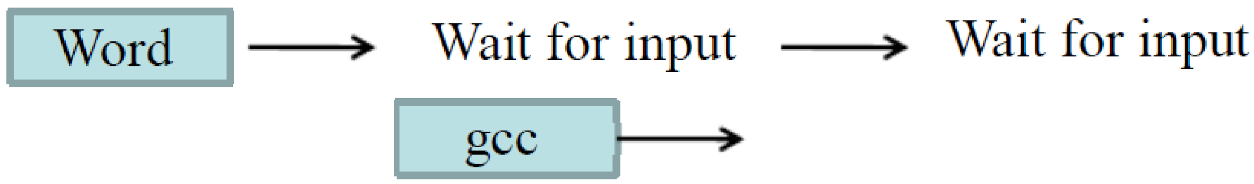
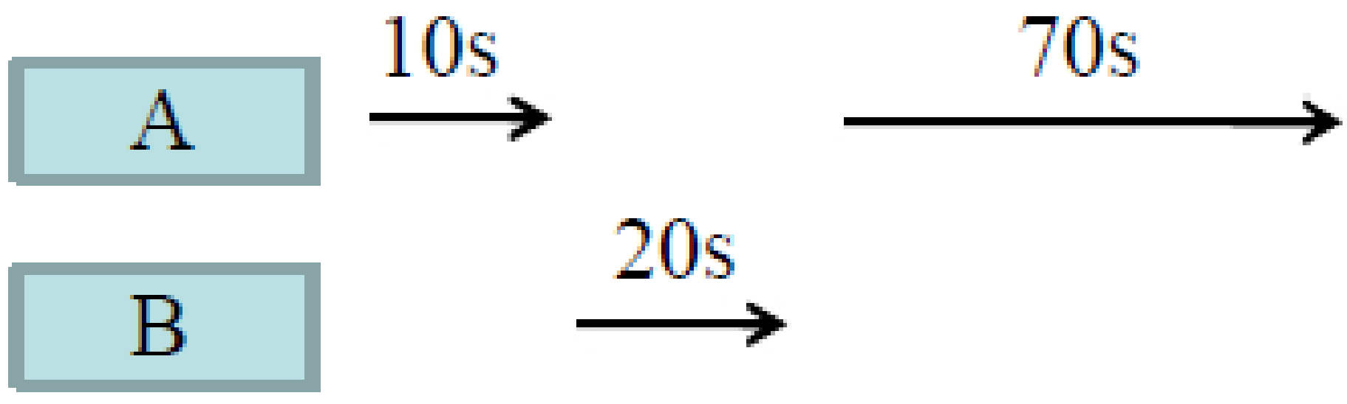
Why Processes? Multiprogramming
(pseudo) concurrent operation with even one CPU
A single CPU at any time may only run one process
Multiple processes increase CPU utilization
Overlap one process’s computation with another’s wait
Multiple processes reduce latency
Running A then B: B takes 100s
Running A and B simultaneously: B takes 30s

Slide 6
Multiprogramming
Multiple programs running
By multiple processes running
To distinguish them, each has a different
Process IDentifier, PID
Different instances of a program have different PIDs
Different instantiated programs have different PIDs

Slide 7
Multiprogramming by Process Switching
Pause execution of one process
Continue with the execution of another process
Operating System functionality (scheduling)
Happens transparently to the process
Programmers cannot make time assumptions
The processes order is not fixed
May not be reproducible

Slide 8
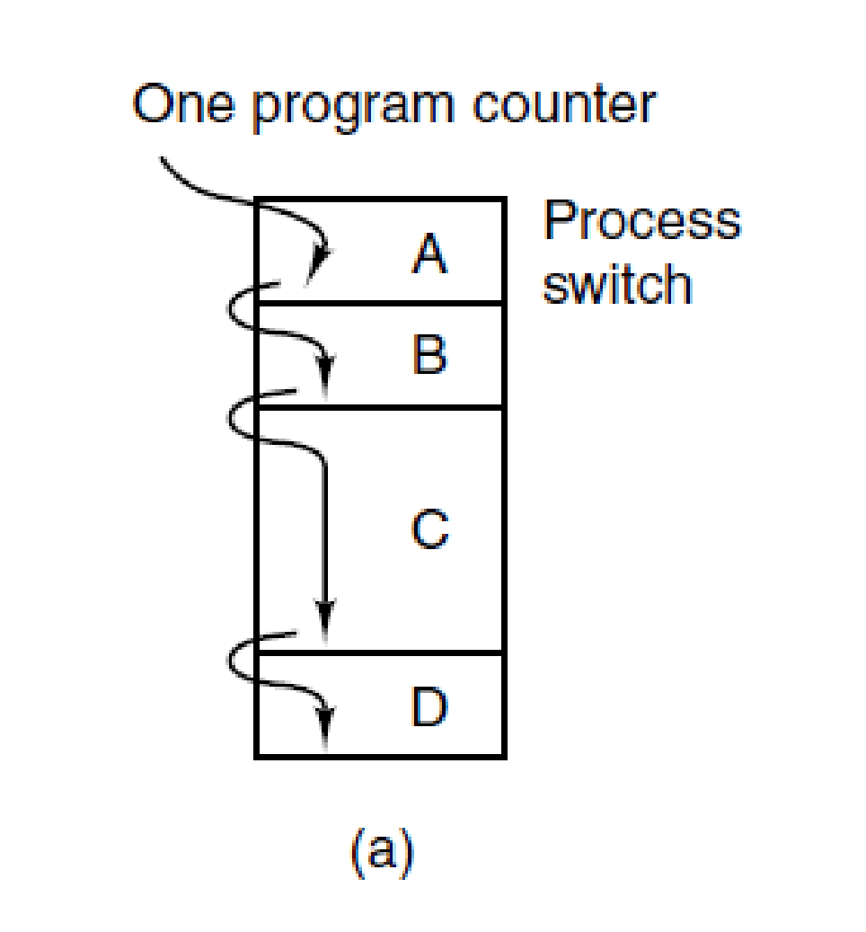
The Process Model (1)
There are four processes A, B, C, and D
There is one (single core/thread) CPU
Process
Switch
execution
time
(a) Multiprogramming of four programs. (MOS Figure 2-1. (a) )

Slide 9
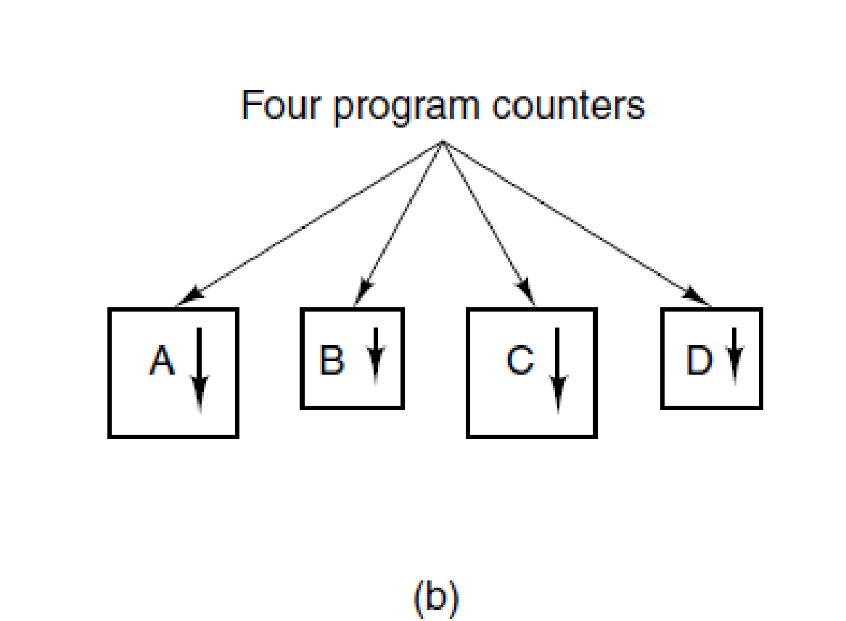
The Process Model (2)
There are four processes A, B, C, and D
(b) Conceptual model of four independent, sequential processes. (MOS Figure 2-1. (b) )

Slide 10
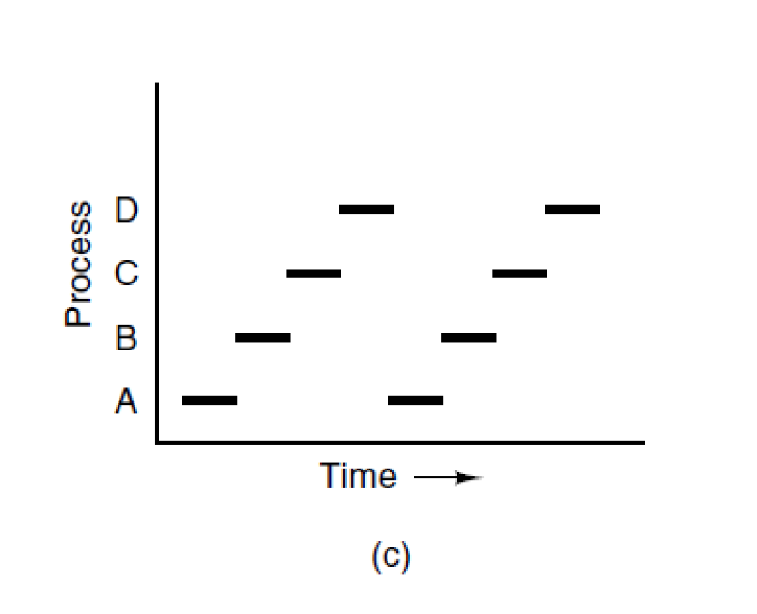
The Process Model (3)
There are four processes A, B, C, and D
There is one (single core/thread) CPU
NOTE
This is just one sequence of execution
Process executing on CPU
(c) Only one program is active at once. (MOS Figure 2-1. (c) )

Slide 11
Process Key Components
Address space/memory
Stack
Heap
Executable program
Initialized data segment (.data)
Text segment (.text)
Execution context
Program counter (PC)
Stack pointer (SP)
CPU registers
…
OS related resources (files …)

Slide 12
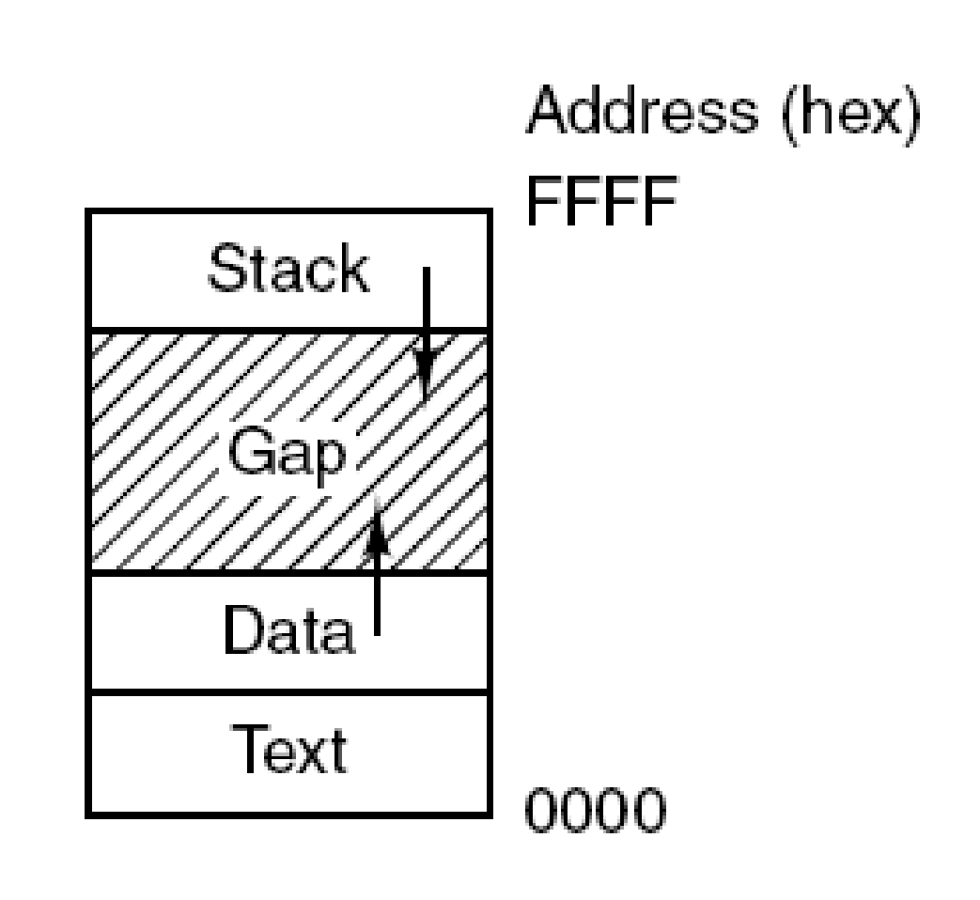
Address Space/Memory Layout (1)
Processes have three main segments: text, data, and stack. (MOS Figure 1-20)

Slide 13
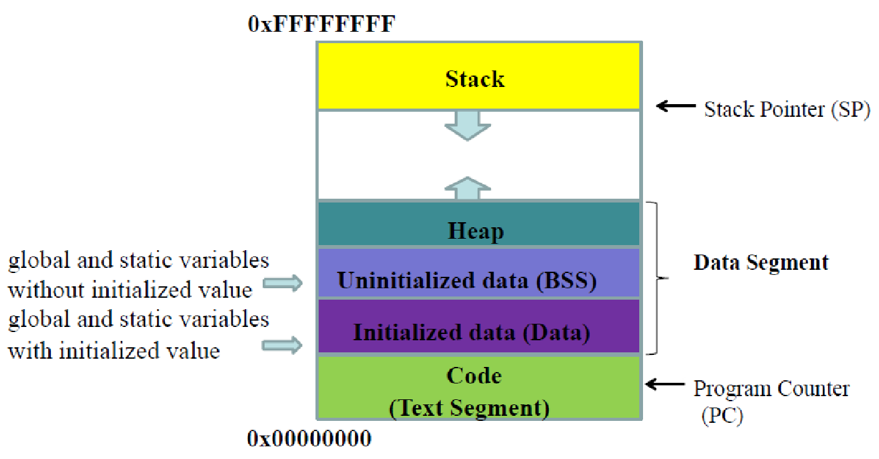
Address Space/Memory Layout (2)

Slide 14
Address Space/Memory Layout (3)
Each process has its own exclusive address space
The content of a specific memory address is different in two different processes
This is true in all classic OSes (this course)
But it is not true for all OSes
The operating system has its own exclusive address space
Operating System functionality (virtual memory)

Slide 15
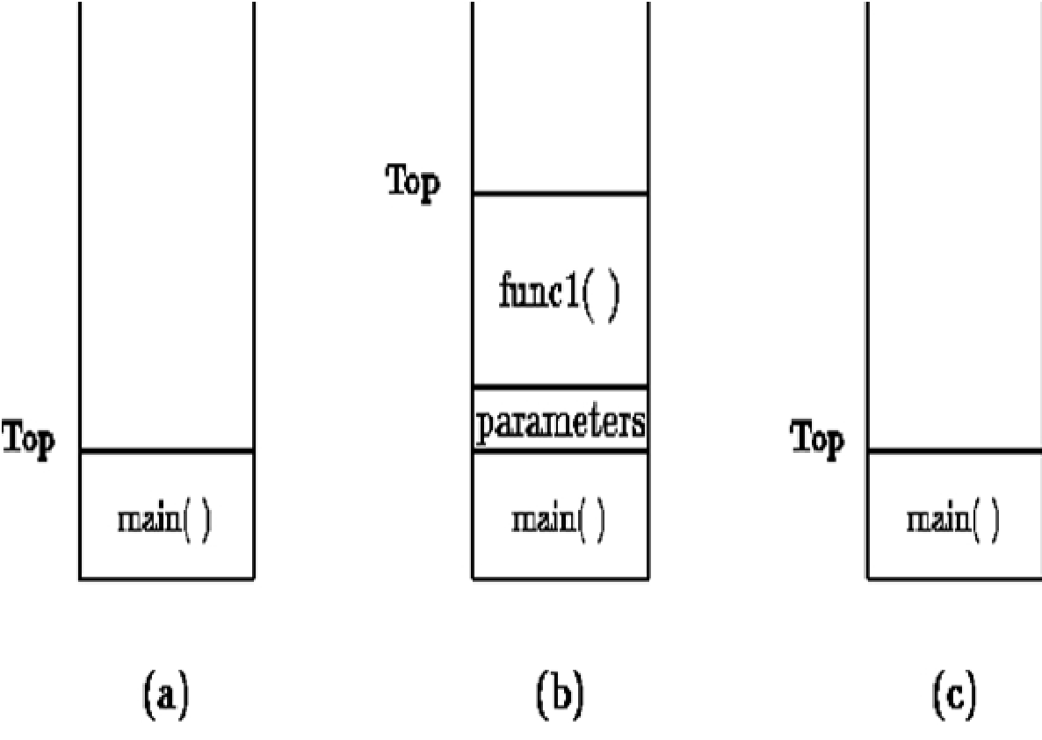
Stack vs Heap (1)
Stack
Built with stack frames
Frames includes local (function) variables
Functions parameters are passed on the stack (not always)
Example
main() is executing
main() calls func1()
func1() returns

Slide 16
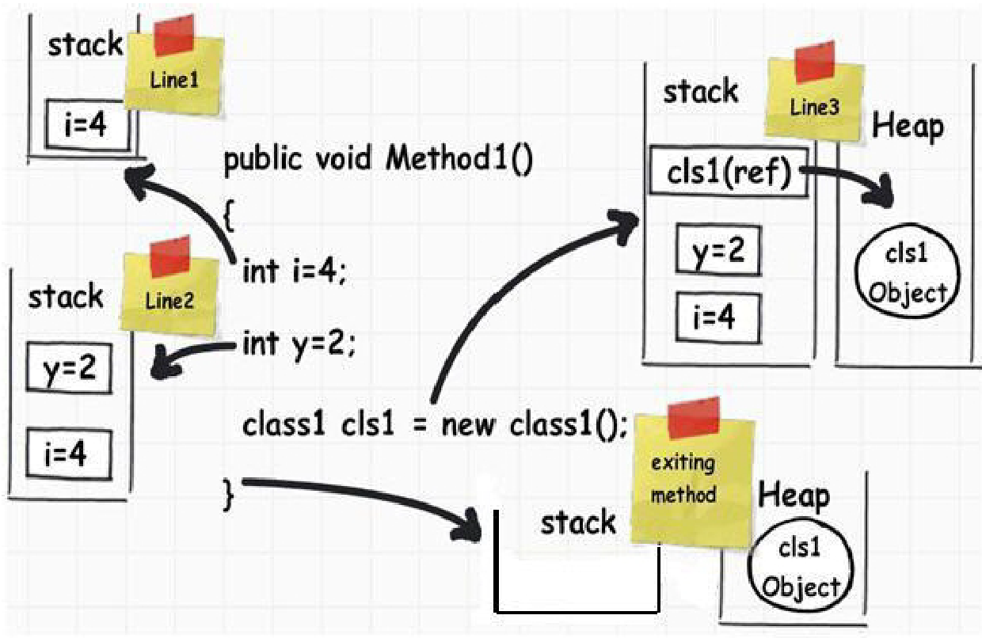
Stack vs Heap (2)
Stack
Static
Last in first out
Used if it is known how much data need to allocate at compile time
Heap
Dynamic
Random Access
Used if it is not known how much data you will need at runtime

Slide 17
Process
Creation, Status and Termination

Slide 18
When Are Processes Created?
During system initialization
From already running processes
Due to user interaction (launching a program)
Execution of a (scheduled) batch job

Slide 19
Process Creation
Different philosophies
UNIX
Create an identical copy of the current process
In the new copy load another program
Windows
Create a new process and load another program in it

Slide 20
UNIX Process Creation (1)
fork() syscall
Parent process, the one that calls the syscall
Child process, the newly created one
When fork() returns
Child and parent look identical (but different copies)
Both continue executing right after the fork() syscall instruction
Child returns a zero value
Parent returns a non-zero value
Their process identification number is different

Slide 21
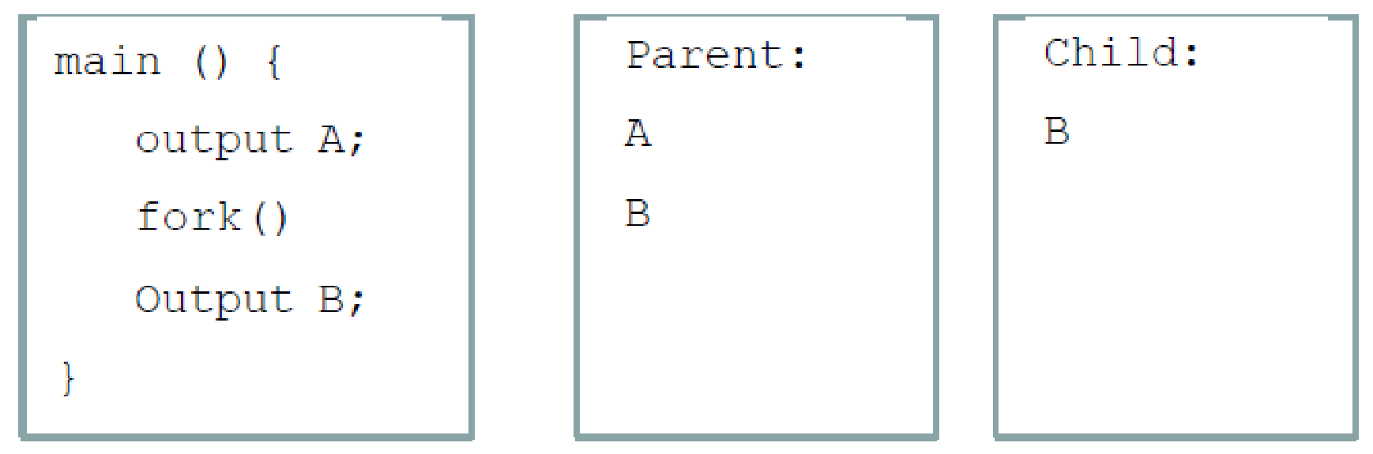
UNIX Process Creation (2)
If the process wanted to create a clone
Done
If the process wanted to load another program
The child calls execve() syscall
execve() changes the child address space by loading a new program
The modified child starts executing from the beginning of the loaded program

Slide 22
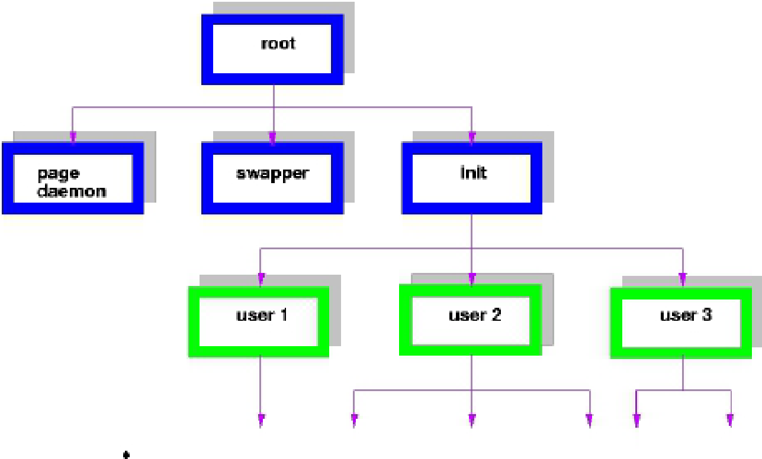
UNIX Process Creation (3)
Parent and children processes form a hierarchy
If a process exits, its children are “inherited” by the exiting process’s parent
The same concept doesn’t exist in Windows
user 2a

Slide 23
UNIX Process Creation (4)
Child and Parent have
Different PIDs
getpid() returns process’s PID
In the Parent, fork() returns the PID of the Child
In the Child, fork() returns 0, not a PID
Separate copies of the address space/memory
Including global variables
Separate execution context, different
Program counter (PC)
Stack pointer (SP)
…

Slide 24
UNIX Process Creation Example
#include <stdio.h>
#include <unistd.h>
int main()
{
int pid1 = getpid(); int pid2;
int ret = fork();
if (ret < 0) { /* error */
printf(“error pid1: %d ret: %d\n”, pid1, ret);
} else if (ret > 0) { /* parent */
pid2 = getpid();
printf(“parent pid2: %d pid1: %d ret: %d\n”, pid2, pid1, ret);
} else { /* child */
pid2 = getpid();
printf(“child pid2: %d pid1: %d ret: %d\n”, pid2, pid1, ret);
}
return 0;
}

Slide 25
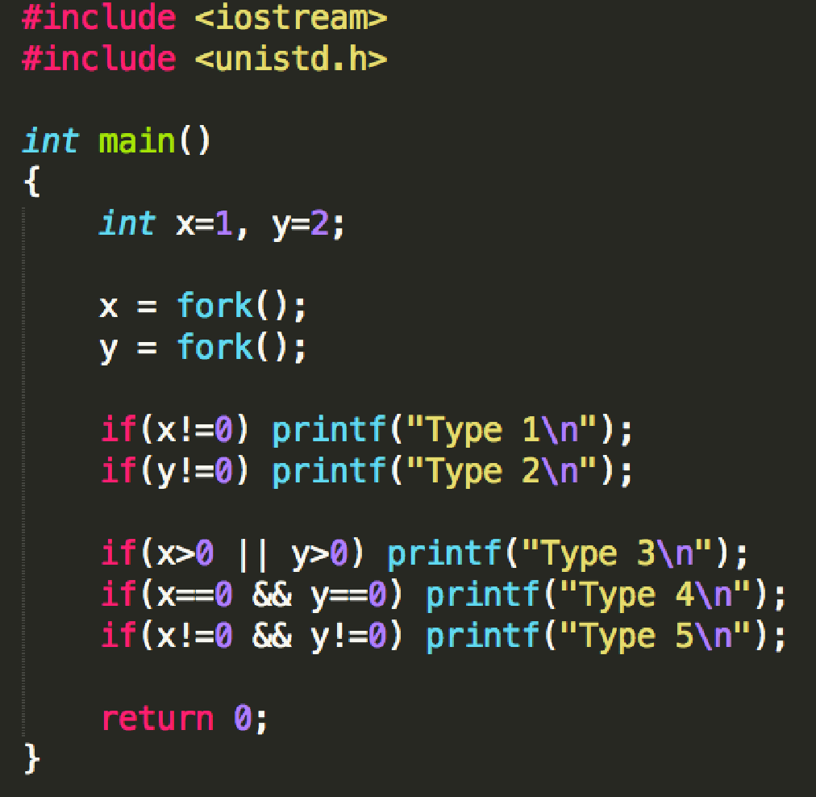
UNIX Process Creation Code Fun
What is the output of this program?

Slide 26
Process State
Execution state – What a process is currently doing
Running – Executing instructions on the CPU
It is the process that has control of the CPU
Ready – Waiting to be assigned to the CPU
Ready to execute, but another process is executing on the CPU
Waiting/blocked – Waiting for an event
It cannot make progress until event is signaled (e.g., IO completes)
For 1-CPU system, how many processes can be in the running state simultaneously?
Notes:
Question: for 1-CPU system, how many processes can be in the running state simultaneously?

Slide 27
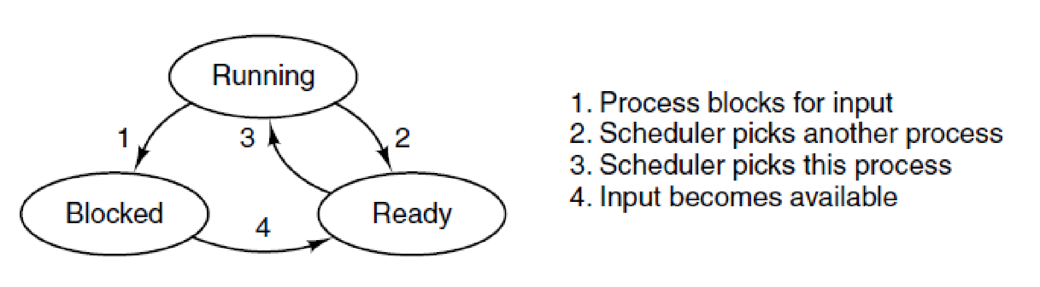
Process State Transitions
A process can be in running, blocked, or ready state. Transitions between these states are as shown. (MOS Figure 2-2)
Why are there transitions missing?

Slide 28
Checking Process State in UNIX
ps UNIX command
STAT column indicates execution state
Example, showing all processes
$ ps ax
What state do you think a process is in most of the time?

Slide 29
Process Termination
Normal exit (voluntary)
Error exit (voluntary)
Example, “file doesn’t exist” error
Fatal error (involuntary)
Example, program bug
Killed by another process (involuntary)

Slide 30
UNIX Process Termination
Voluntary exit
exit() syscall
Involuntary exit
fatal program bug (not all bugs are fatal, immediately) → causes HW interrupt → causes kernel to send a signal that will cause process termination (unless handled)
process explicitly signals process
kill() syscall
kill UNIX command
Windows has equivalents
Termination of a parent processes does not kill children processes
The children’s parent will be the parent’s parent

Slide 31
OS Data Structures

Slide 32
Process Data Structures
How does the OS represents a process?
Maintains a table called Process Table
Process Table has one entry per process
The entry is called Process Control Block (PCB)
A PCB contains all info about a process
Process Table
PCB0
PCB1
PCB2
…

Slide 33
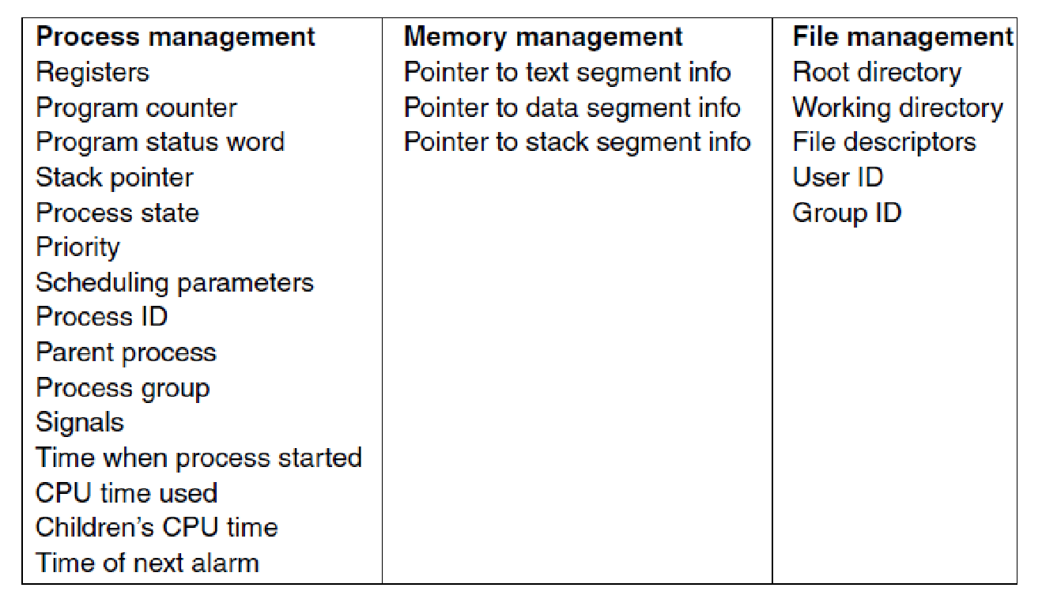
Process Table Entry (or PCB)
Some of the fields of a typical process table entry. (MOS Figure 2-4)

Slide 34
Process Switching

Slide 35
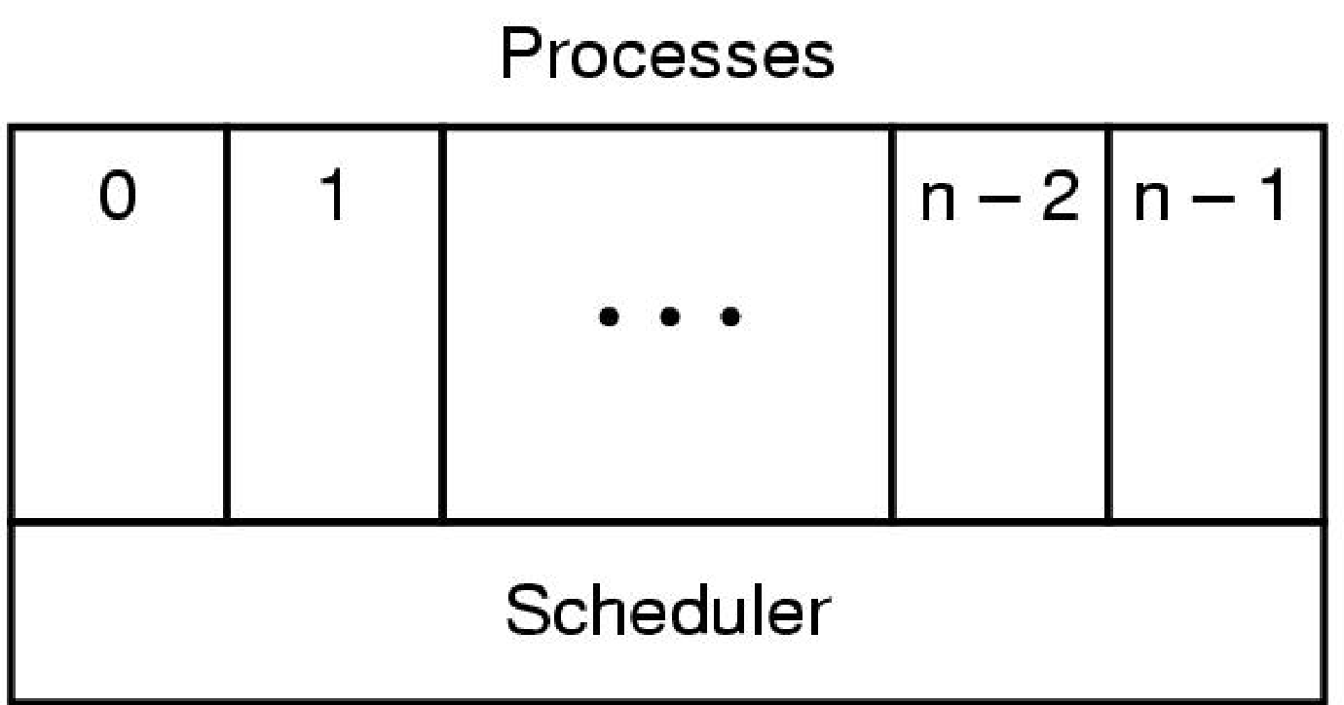
Process Switching by the Scheduler
Operating System
The lowest layer of a process-structured operating system handles interrupts and scheduling. Above that layer are sequential processes. (MOS Figure 2-3)

Slide 36
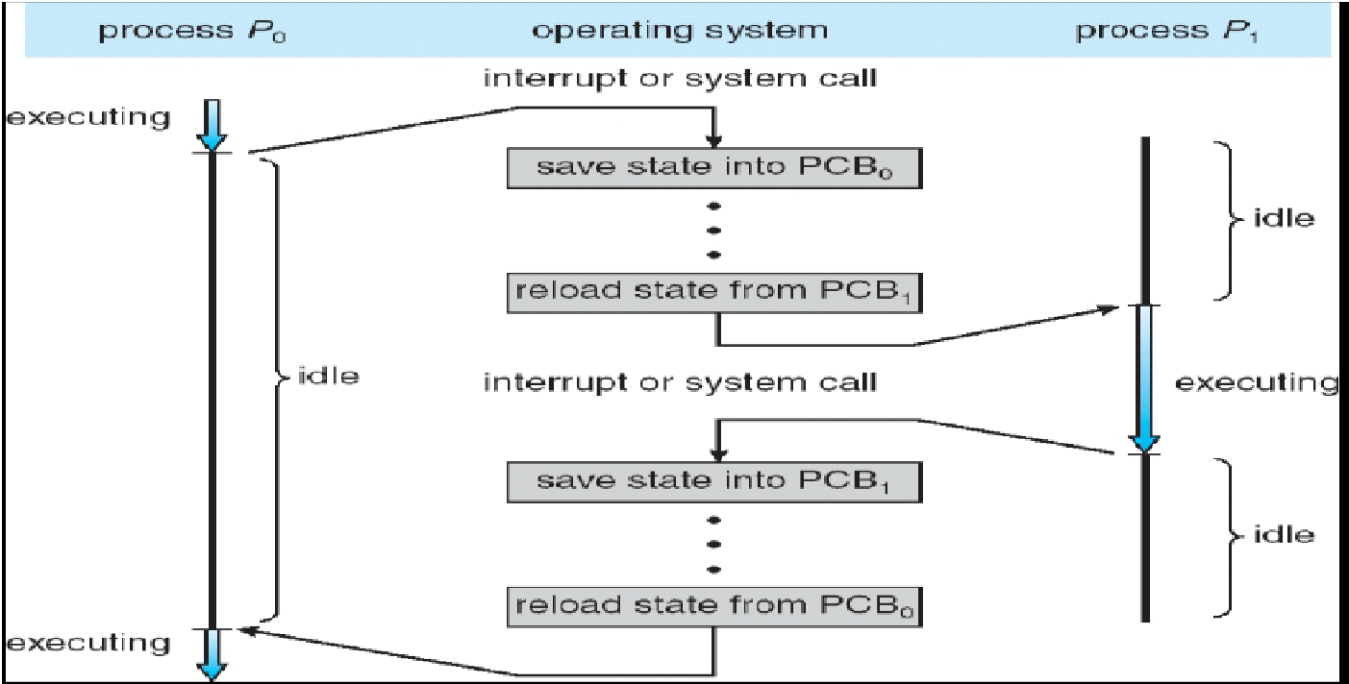
How Process Switching Works (1)
(Running)
(Ready)
(Ready or
Blocked)
(Running)
…
(Ready)
(Ready or
Blocked)
(Running)

Slide 37
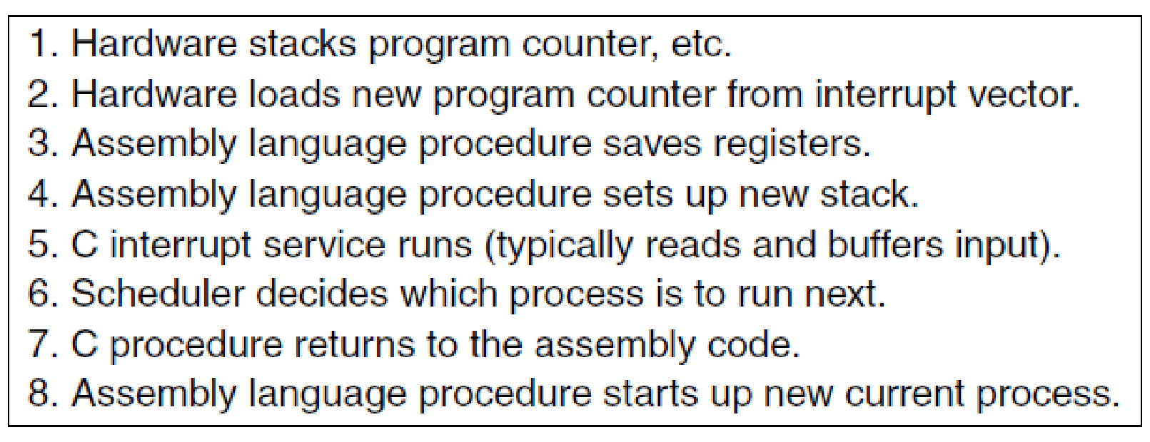
How Process Switching Works (2)
Skeleton of what the lowest level of the operating system does when an interrupt occurs. (MOS Figure 2-5)

